Slide 1
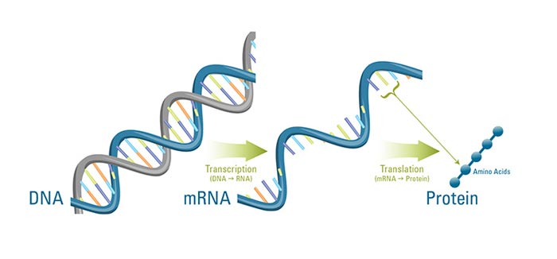
Genes and Proteins

Slide 2
Learning Outcomes
Explain how the genetic code determines the amino acid sequence in proteins;
Describe transcription in Prokaryotes and Eukaryotes;
Explain RNA processing in Eukaryotes;
Explain the process of protein synthesis;

Slide 3
Central Dogma
The genetic code determines the amino acid sequence in proteins;
The central dogma defines protein synthesis;
Central Dogma
DNA → RNA → Protein
This unidirectional flow represents the Central Dogma (fundamental law) of molecular biology;
This is the mechanism whereby inherited information is used to create actual objects, namely enzymes and structural proteins;

Slide 4
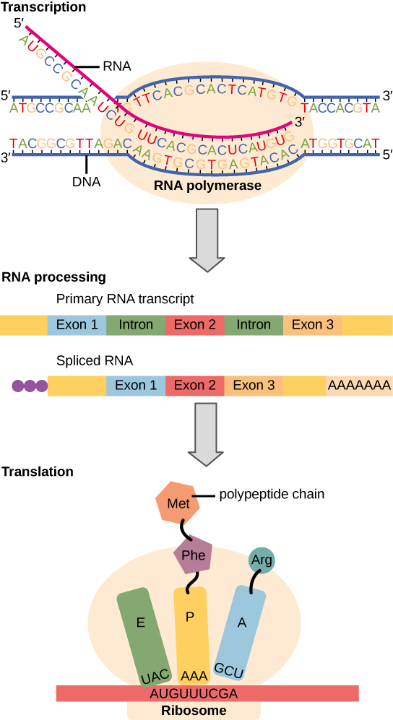
Flow of genetic information
Instructions on DNA are transcribed onto messenger RNA.
Ribosomes are able to read the genetic information inscribed on a strand of messenger RNA.
They use this information to string amino acids together into a protein.

Slide 5
Degeneracy of the genetic code
Nucleotides in an mRNA sequence code for amino acids in 3 nucleotide portions known as codons.
The reading frame refers to which nucleotide starts the first codon; for each segment of DNA, there a 6 possible reading frames.
There are 64 possible codons that code for the 20 amino acids and 3 stop codons meaning that multiple codons can specify one amino acid.

Slide 6
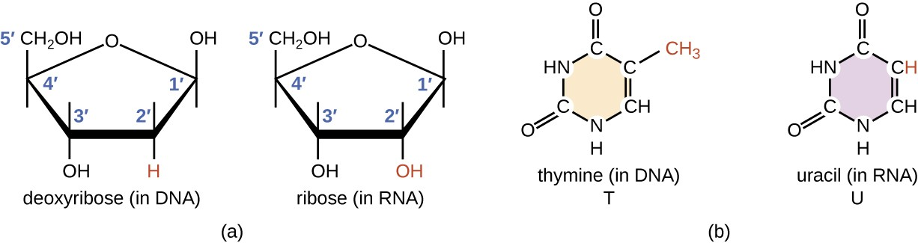
Transcription and RNA
DNA structure as a double helix makes it suitable for being the molecular basis for heredity;
A gene’s expression to protein is carried out by a DNA related molecule, an RNA;
RNA is ribonucleic acid, a single-stranded molecule;

Slide 7
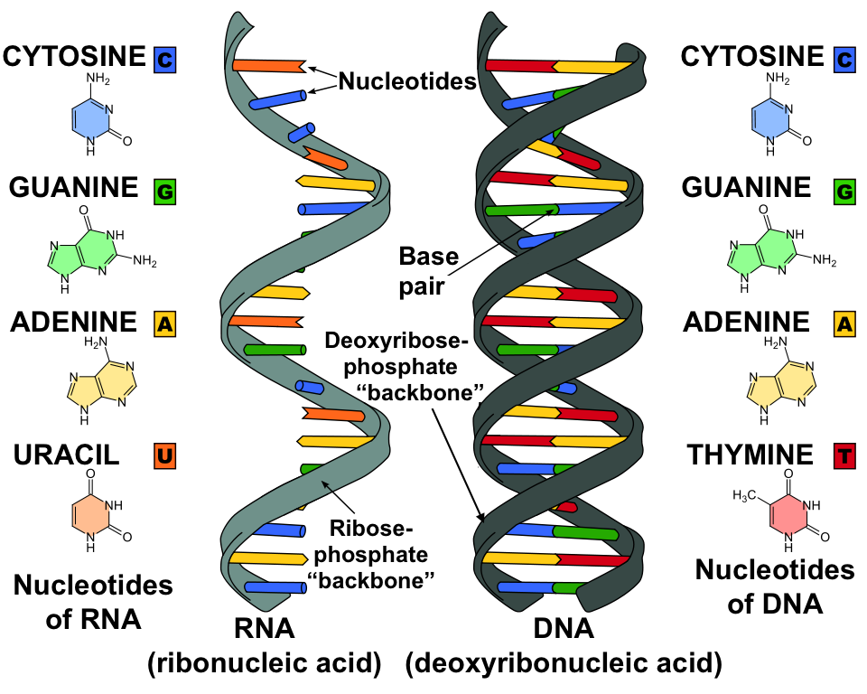
Transcription and RNA
Notes:
Unlike double-stranded DNA, RNA is a single-stranded molecule in many of its biological roles and consists of much shorter chains of nucleotides.
However, a single RNA molecule can, by complementary base pairing, form intrastrand double helixes, as in tRNA.

Slide 8
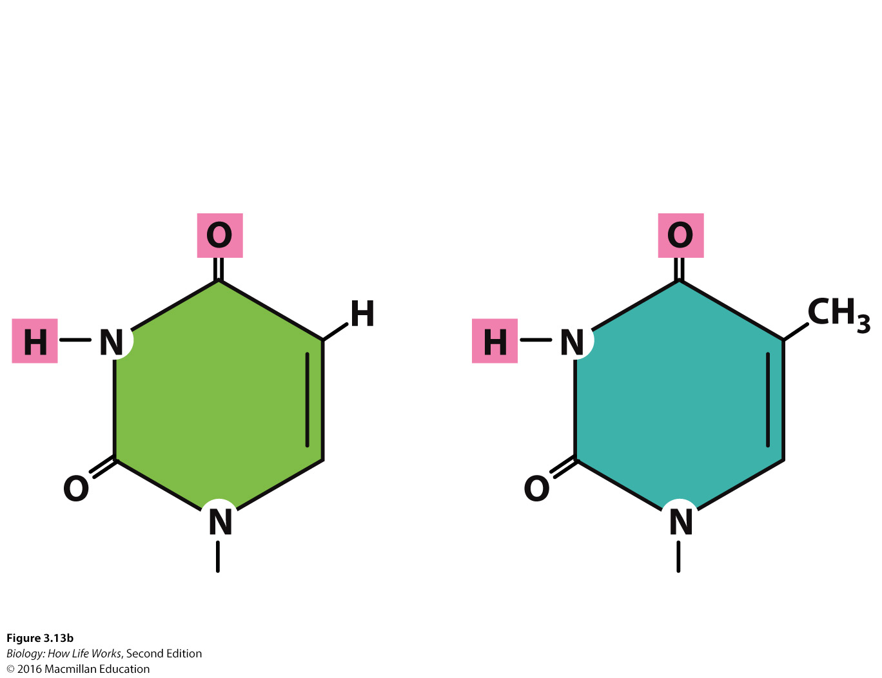
DNA vs. RNA
Uracil has a hydrogen (–H) where thymine has a methyl (–CH₃) group.
Uracil
(U)
Thymine (T)
Ribose
Deoxyibose

Slide 9
Why is uracil rather than thymine used in RNA?
Uracil is energetically less expensive to produce than thymine.
RNA is comparatively short-lived molecule
Notes:
One major problem with using uracil as a base is that cytosine can be deaminated, which converts it into uracil. This is not a rare reaction; it happens around 100 times per cell, per day. This is no major problem when using thymine, as the cell can easily recognize that the uracil doesn't belong there and can repair it by substituting it by a cytosine again.
There is an enzyme, uracil DNA glycosylase, that does exactly that; it excises uracil bases from double-stranded DNA. It can safely do that as uracil is not supposed to be present in the DNA and has to be the result of a base modification.
Now, if we would use uracil in DNA it would not be so easy to decide how to repair that error. It would prevent the usage of this important repair pathway.
The inability to repair such damage doesn't matter for RNA as the mRNA is comparatively short-lived and any potential errors don't lead to any lasting damage. It matters a lot for DNA as the errors are continued through every replication. Now, this explains why there is an advantage to using thymine in DNA, it doesn't explain why RNA uses uracil. I'd guess it just evolved that way and there was no significant drawback that could be selected against, but there might be a better reason (more difficult biosynthesis of thymine, maybe?).

Slide 10
DNA vs. RNA
 | DNA | RNA
Sugar | Deoxyribose | Ribose
Bases | A, T, C, G | A, U, C, G
5′ end | Monophosphate | Triphosphate
Size | Very large | Smaller
Strands | Double | Single
Notes:
Review table.

Slide 11
Transcription and RNA
Activity 1
Which of the following correctly describes the Central Dogma?
a. RNA → DNA → Protein
b. DNA → RNA → Protein
c. RNA → Protein → DNA
d. Protein → DNA → RNA
Activity 2
What is not a difference between RNA and DNA?
a. The DNA base pairs are: A-T whereas the RNA base pairs are : A-U;
b. The sugar in DNA is deoxyribose whereas in RNA is ribose;
c. DNA consists of two strands whereas RNA only has one strand;
d. DNA is an acid whereas RNA in an alkali;

Slide 12
Steps of transcription
Initiation
  Promoter is a piece of DNA upstream that indicates where the RNA polymerase should bind and start
Elongation
  RNA polymerase adds complimentary nucleotides (A, U, C, G) to make the mRNA
Termination
Note: Since there is no nuclear membrane in prokaryotes, there is no separation of the transcription and translation process.
A ribosome will “grab onto” the growing mRNA to start translation

Slide 13
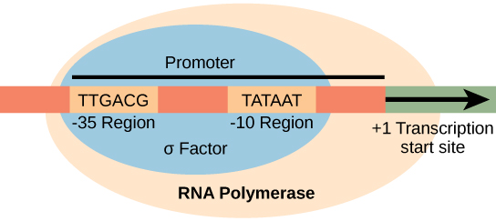
Initiation
The σ subunit of prokaryotic RNA polymerase recognizes consensus sequences found in the promoter region upstream of the transcription start sight. The σ subunit dissociates from the polymerase after transcription has been initiated.

Slide 14
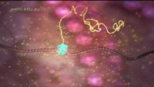
The first part of Transcription

Slide 15
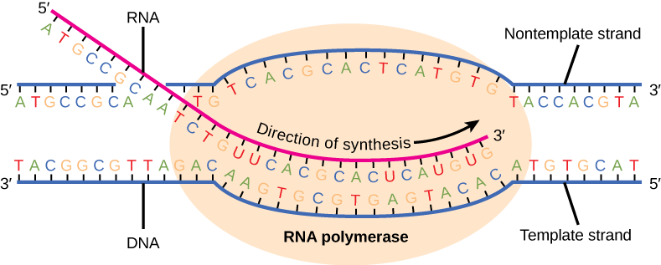
Elongation
During elongation, the prokaryotic RNA polymerase tracks along the DNA template.
Then it synthesizes mRNA in the 5' to 3' direction, and unwinds and rewinds the DNA as it is read.
Elongation occurs at a rate of 40 nucleotides per second.

Slide 16
termination
Liberates the mRNA strand
Occurs by:
  Rho protein interaction
  Formation of an mRNA hairpin
Two types of termination signals:
  Rho-dependent (controlled by the Rho protein)
  Rho-independent (controlled by sequences in the DNA strand)

Slide 17
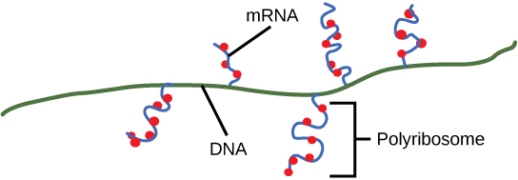
Multiple polymerases can transcribe a single bacterial gene while numerous ribosomes concurrently translate the mRNA transcripts into polypeptides. In this way, a specific protein can rapidly reach a high concentration in the bacterial cell.

Slide 18
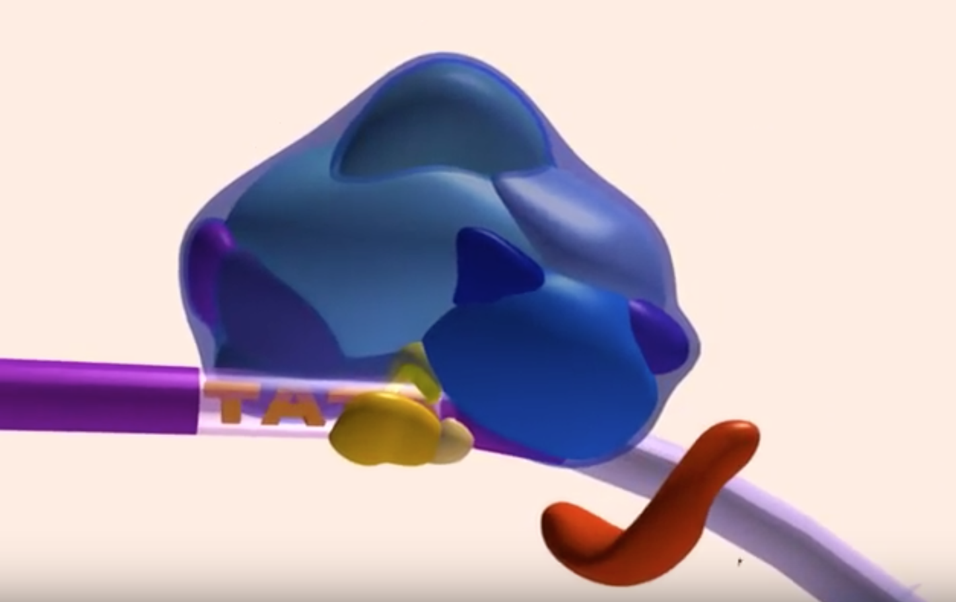
Transcription
https://www.youtube.com/watch?v=WsofH466lqk

Slide 19
Termination
RNA polymerase I requires a termination protein that recognizes a specific 18 nucleotide sequence.
RNA polymerase III terminates transcription via hairpin formation.
RNA polymerase II transcribes 1,000 – 2,000 nucleotides excess of the gene template which are removed during mRNA processing.

Slide 20
Types of eukaryotic polymerases
RNA polymerase I
  Transcribes rRNA genes
RNA polymerase II
  Transcribes protein-coding genes
RNA polymerase III
  Transcribes rRNA, tRNA, and small nuclear RNA genes

Slide 21
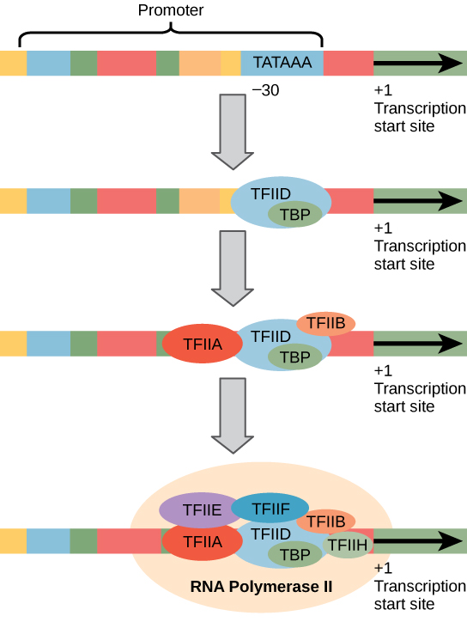
Initiation
Transcription factors recognize the promoter.
RNA polymerase II then binds and forms the transcription initiation complex.

Slide 22
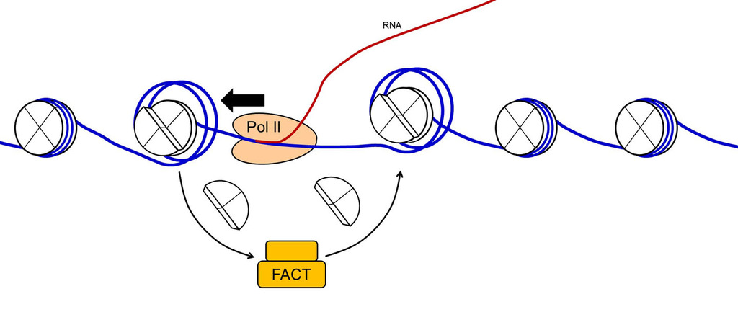
elongation
mRNA is synthesized 5’ to 3’
The FACT complex reassembles the nucleosomes as polymerase synthesizes the mRNA

Slide 23
mRNA processing
Addition of a 5' methylguanosine cap and a 3’ poly-A tail
Intron splicing – removal of the non-coding introns.

Slide 24
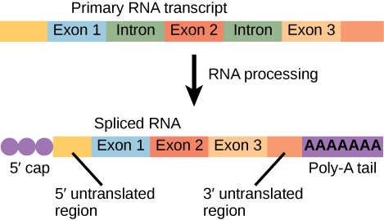
mRNA Processing
Eukaryotic mRNA contains introns that must be spliced out. A 5' cap and 3' poly-A tail are also added.

Slide 25
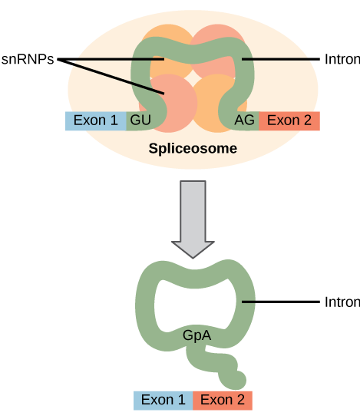
Pre-mRNA Splicing
Pre-mRNA splicing involves the precise removal of introns from the primary RNA transcript.
The splicing process is catalyzed by protein complexes called spliceosomes that are composed of proteins and RNA molecules called snRNAs.
Spliceosomes recognize sequences at the 5' and 3' end of the intron.

Slide 26
Rna and Trna processing
Intramolecular cleavage
Splicing
Methylation
Chemical conversion of nucleotides

Slide 27
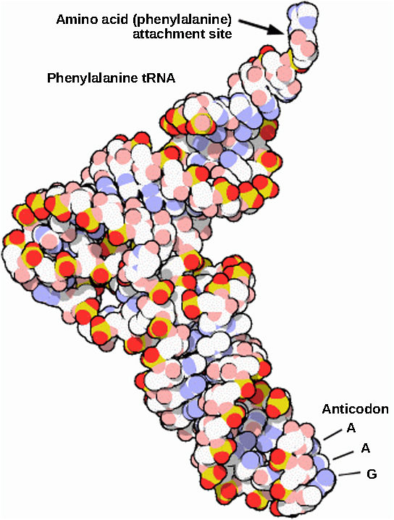
Rrna and Trna processing
This is a space-filling model of a tRNA molecule that adds the amino acid phenylalanine to a growing polypeptide chain.
The anticodon AAG binds the Codon UUC on the mRNA.
The amino acid phenylalanine is attached to the other end of the tRNA.

Slide 28
Translation
The process in which the mRNA code is used in protein synthesis is called translation;
U
codon
C
mRNA
Number of possible codons=4³=64
A
G
61 codons code for 20 possible
amino acids;
codon
U
A
C
U
In translation, a base-pair sequence in the mRNA is converted into an amino acid sequence;
Proteins are made of amino acids sequences;
Notes:
3 out of 64 codons are stop codons and they do not encode an amino acid. Thus, 61 codons encode 20 amino acids.

Slide 29
protein synthesis
Decodes mRNA to produce a polypeptide
Polypeptides are formed when the amino group of one amino acid forms an amide (i.e., peptide) bond with the carboxyl group of another amino acid.
The reaction is catalyzed by ribosomes.

Slide 30
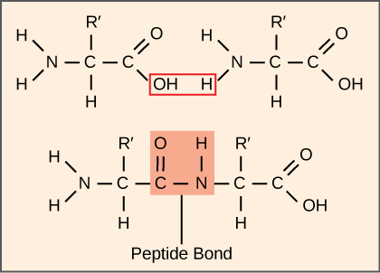
Peptide Bond
A peptide bond links the carboxyl end of one amino acid with the amino end of another, expelling one water molecule. For simplicity in this image, only the functional groups involved in the peptide bond are shown. The R and R' designations refer to the rest of each amino acid structure.

Slide 31
Translation Process
Initiation
    mRNA attaches to the smaller subunit of the ribosome
    AUG is the start codon – a tRNA with the appropriate anticodon attaches
    The larger subunit of the ribosome then comes in
Elongation
    tRNAs move in with the appropriate amino acid, the amino acid chain grows using peptidyl transferase
Termination
    Stop codon is reached
    The amino acid chain then is processed
        In eukaryotes, the amino acid chain moves into the endoplasmic reticulum to be further processed

Slide 32
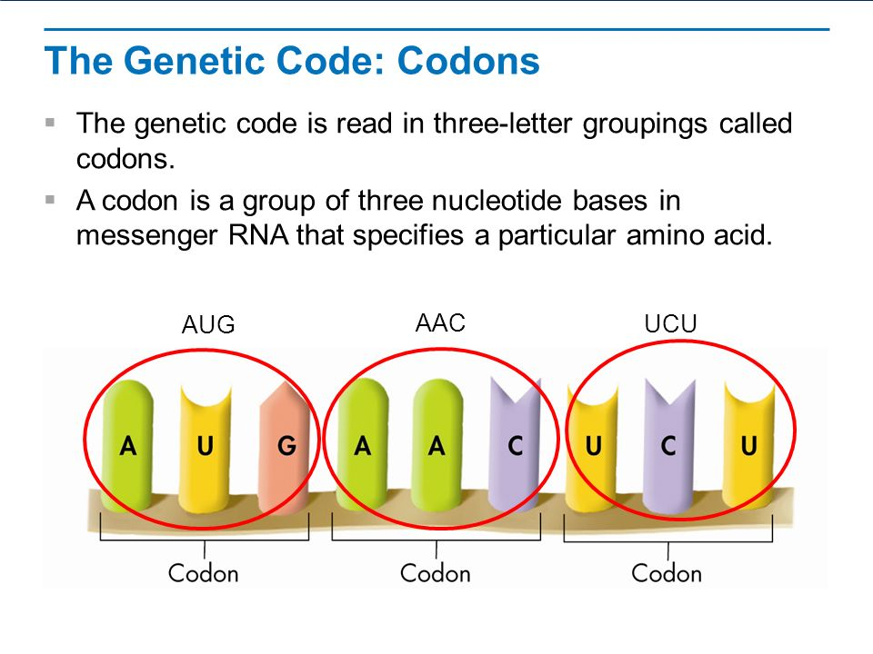
Translation

Slide 33
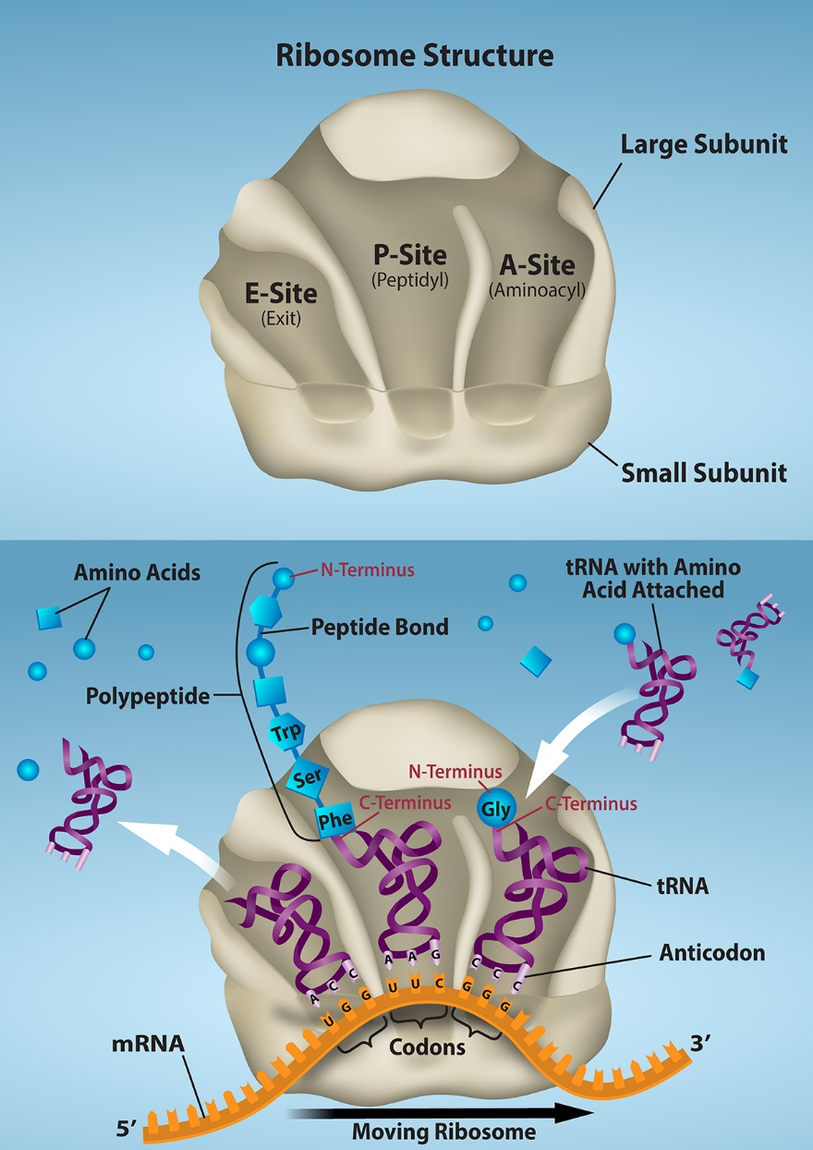
Protein Synthesis
The ribosome is responsible for translating the mRNA into protein.
The ribosome consists of a large and small ribosomal subunit. Assembly of the subunits on the mRNA forms three tRNA binding sites.
During translation, charged tRNAs enter the Acceptor site, and the anticodon on the tRNA base pairs with the codon in the mRNA.

Slide 34
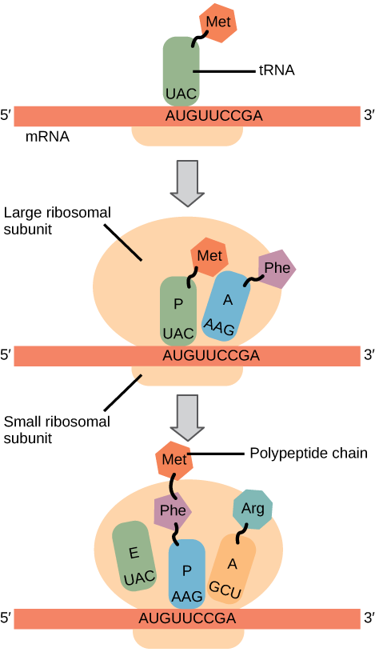
Translation Process

Slide 35
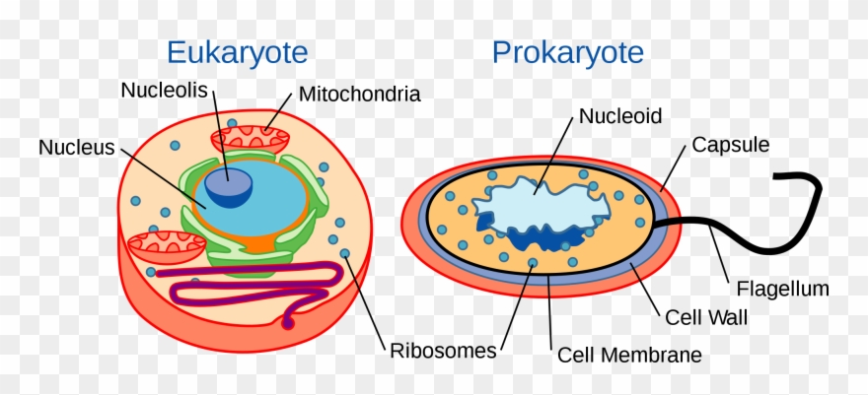
Ribosomes and Protein Synthesis
Ribosomes are the sites in a cell in which protein synthesis takes place;
Cells have many ribosomes, and the exact number depends on how active a particular cell is in synthesising proteins;
For example, rapidly growing cells usually have a large number of ribosomes;
(DNA)
(DNA)

Slide 36
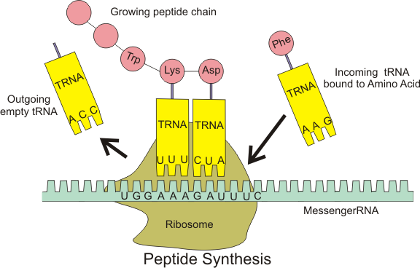
Ribosomes and Protein Synthesis
Ribosomal subunits proceed to attract tRNA molecules;
Transfer ribonucleic acid, tRNA, is a type of RNA molecule that helps decode a messenger RNA (mRNA) sequence into a protein;
A long chain of amino acids emerges as the ribosome decodes the mRNA sequence into a polypeptide, or a new protein;
Notes:
In order for translation to start, we need a few key ingredients. These include:
A ribosome;
An mRNA with instructions for the protein synthesis;
An "initiator" tRNA carrying the first amino acid in the protein, which is almost always methionine (Met);
During initiation, these pieces must come together forming the initiation complex, the molecular setup needed to start making a new protein.
In translation, the codons of an mRNA are read in order (from the 5' end to the 3' end) by molecules called transfer RNAs, or tRNAs.
Each tRNA has an anticodon, a set of three nucleotides that binds to a matching mRNA codon through base pairing. The other end of the tRNA carries the amino acid that's specified by the codon of mRNA.

Slide 37
Translation: The Genetic Code
The genetic code translates nucleotide sequences (codons) into amino acids;
“Decoding messages” is a key step in gene expression, in which information from a gene is read out to build a protein;
The genetic code allows DNA and RNA sequences to be "decoded" into the amino acids of a protein;
Codons
Cells decode mRNAs by reading their nucleotides in groups of three, called codons;
Some features of codons are listed below:
most codons specify an amino acid;
codons that specify the same amino acids typically differ by one nucleotide;
three "stop" codons mark the end of a protein;
one "start" codon, AUG, marks the beginning of a protein and also encodes the amino acid methionine;

Slide 38
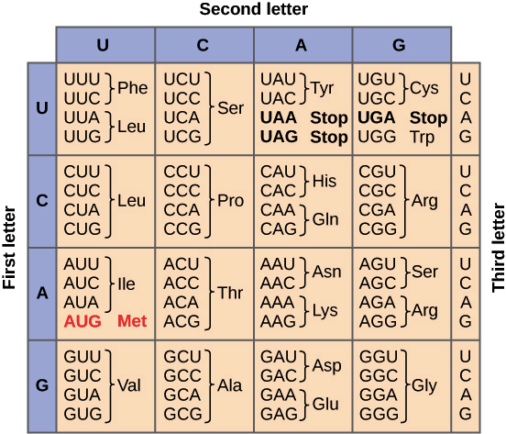
Translation: The Genetic Code
The full set of relationships between codons and amino acids is called the genetic code. The genetic code is summarised in the table below.

Slide 39
Translation: The Genetic Code
Some amino acids are represented by more than one codon;
The genetic code is degenerate because a number of different codons specify the same amino acid. For instance, there are six different ways (6 codons) to produce leucine, Leu, in the language of mRNA;
The genetic code in protein synthesis is universal and applicable (with minor exceptions) to all species (from bacteria to humans);

Slide 40
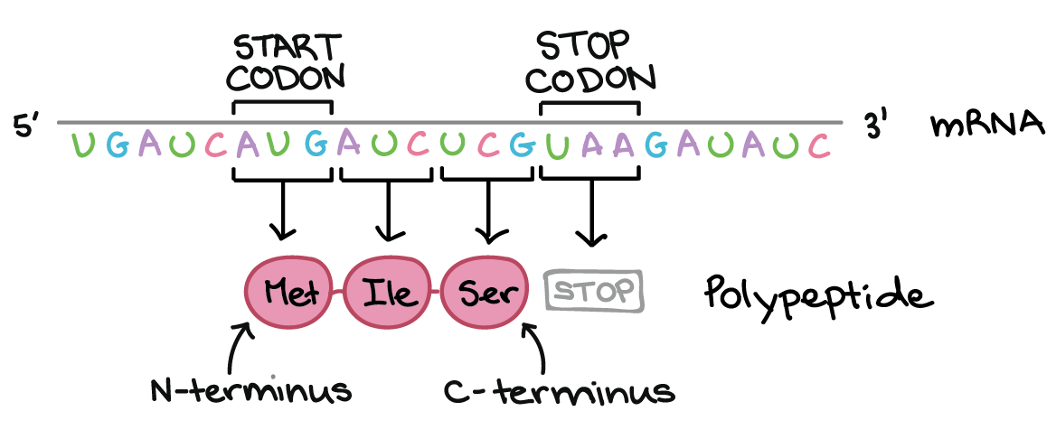
Translation: The Genetic Code
Codons in an mRNA are read during translation, beginning with a start codon and continuing until a stop codon is reached;
mRNA codons are read in a 5' to 3’ direction, and they specify the order of amino acids in a protein from N-terminus (methionine) to C-terminus;
Stop codons do not code for an amino acid and signal the release of polypeptide.
Notes:
Translation continues until a stop codon is reached. There are three stop codons in the genetic code, UAA, UAG, and UGA. Unlike start codons, stop codons don't correspond to an amino acid. Instead, they act as "stop" signals, indicating that the polypeptide is complete and causing it to be released from the ribosome. More nucleotides may appear after the stop codon in the mRNA, but will not be translated as part of the polypeptide.
N-terminus and C-terminus are the two ends of the polypeptide. N-terminus is always methionine and C-terminus is the last amino acid produced (the one coded by the second last codon).

Slide 41
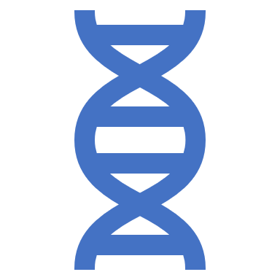
Translation: The Genetic Code
Reading frame
Reading frame ensures that information is reliably transferred from an mRNA to a protein;
Reading frame determines how the mRNA sequence is divided up into codons during translation;
The mRNA in the next slide can encode three totally different proteins, depending on the frame in which it is read;
The start codon is critical because it determines where translation will begin on the mRNA.

Slide 42
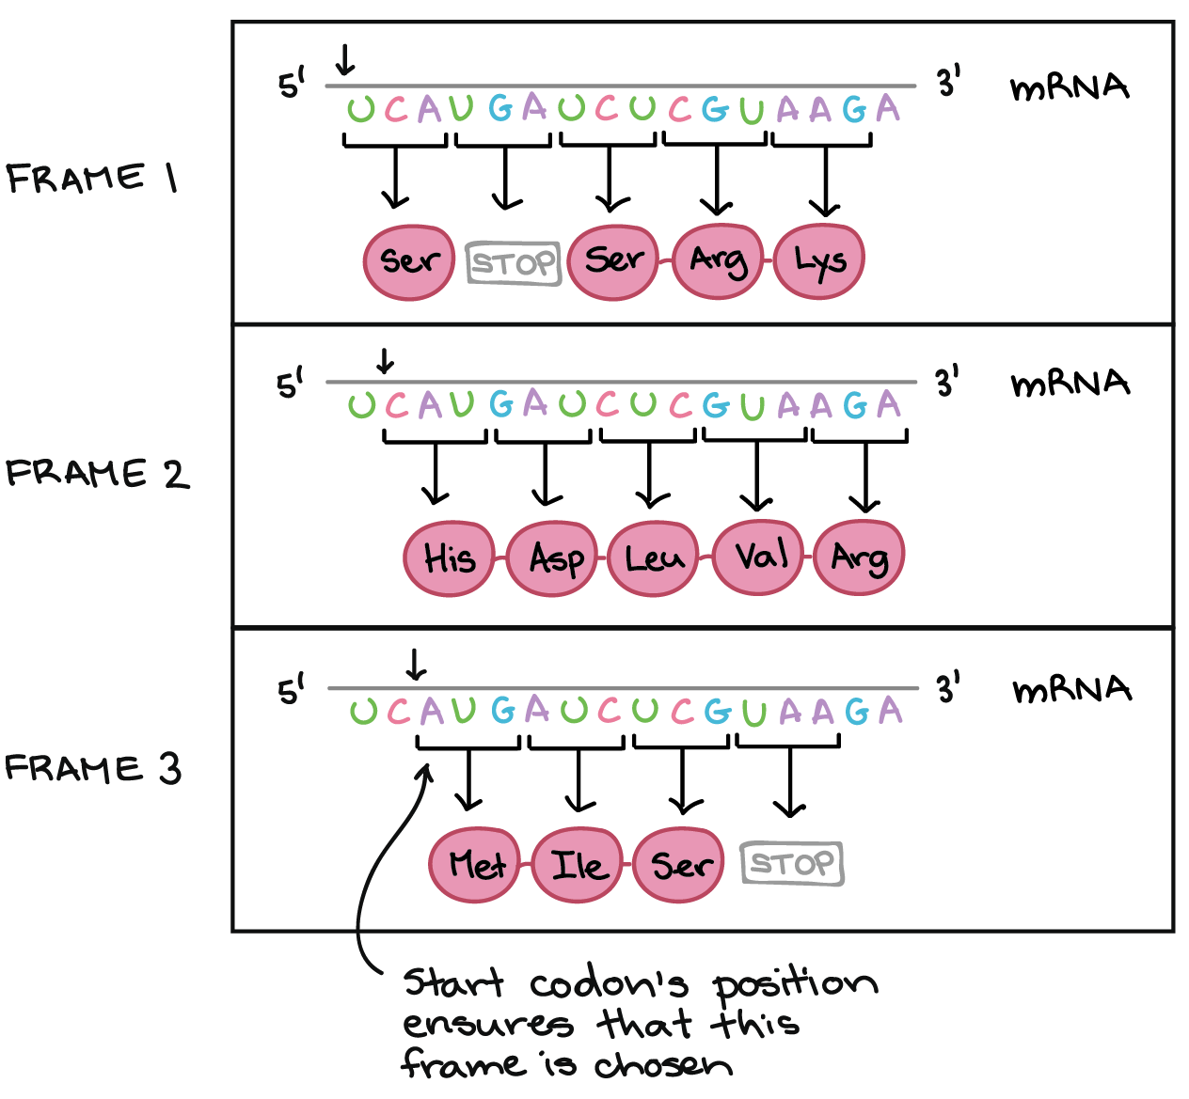
Translation: The Genetic Code
Notes:
The start codon is critical because it determines where translation will begin on the mRNA. Most importantly, the position of the start codon determines the reading frame, or how the mRNA sequence is divided up into groups of three nucleotides inside the ribosome. As shown in the diagram above, the same sequence of nucleotides can encode completely different polypeptides depending on the frame in which it's read. The start codon determines which frame is chosen and thus ensures that the correct polypeptide is produced (frame 3).
An important point to note here is that the nucleotides in a gene are not physically organised into groups of three. Instead, what constitutes a codon is simply a matter of where the ribosome begins reading, and of what sequence of nucleotides comes after the start codon.
Mutations that insert or delete a single nucleotide may alter reading frame, resulting in the production of an incorrect protein.

Slide 43
Translation: The Genetic Code
So, how does a cell know which of proteins to make?
The start codon, AUG, is the key signal;
Because translation begins at the start codon and continues in successive groups of three, the position of the start codon ensures that the mRNA is read in the correct frame (in the previous example frame 3);
Insertions and deletions of nucleotides can cause frameshift mutations;
Mutations (changes in DNA) that insert or delete one or two nucleotides can change the reading frame, causing an incorrect protein to be produced "downstream" of the mutation site;

Slide 44
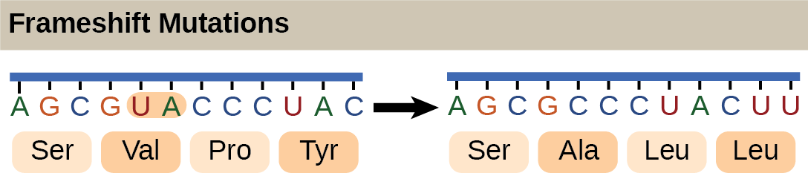
Frameshift mutations
The deletion of two nucleotides shifts the reading frame of an mRNA and changes the entire protein message, creating a nonfunctional protein or terminating protein synthesis altogether.

Slide 45
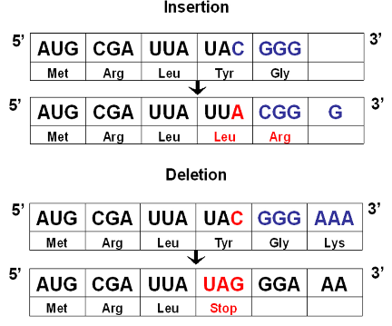
Translation: The Genetic Code
Frameshift Mutations
Insertion of a nucleotide (one base A)
Deletion of a nucleotide (one base C)
Notes:
Frameshift mutations result from environmental factors such as ultraviolet radiation from the sun, or can occur if an error is made as DNA copies itself during cell division.
An illness such as cancer can also cause these mutations.

Slide 46
Translation: The Genetic Code
Activity 3
The genetic code is degenerate because:
a. 61 codons define 20 amino acids;
b. 20 codons define 64 amino acids;
c. 64 codons define 24 amino acids;
d. 20 codons define 20 amino acids;
Activity 4
In protein synthesis, a frameshift mutation results from:
a. insertions or deletions of nucleotides;
b. the start codon AUG;
c. the stop codon UGA;
d. the stop codon UAA;

Slide 47
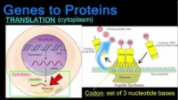
Gene and Protein

Slide 48


Questions?

